Slide 1
Sales Analyse Presentations
Data: Super Market Sale
Sourab Hossain

Slide 2
Introduction
This analytical report's goal is to offer a comprehensive analysis of a supermarket's sales data. The data set includes details on the sales of various products over a three-month period in the supermarket. This report aims to shed light on the performance of the supermarket, the trends in product sales, and consumer behaviour.
Data :- Super Market Sales (Link)
Source = Kagle

Slide 3
Data Overview :
The dataset contains 1,000 observations and 17 variables. The variables are as follows:
Invoice ID: Unique identification number for each transaction
Branch: Branch of the supermarket
City: City where the branch is located
Customer Type: Type of customer (Member or Normal)
Gender: Gender of the customer
Product Line: Product category (Electronic accessories, Fashion accessories, Food and beverages, Health and beauty, Home and lifestyle, Sports and travel)
Unit Price: Price of the product
Quantity: Quantity of the product sold
Tax: Tax applied on the product
Total: Total price of the product (including tax)
Date: Date of the transaction
Time: Time of the transaction
Payment: Payment method (Cash or Credit card)
cogs: Cost of goods sold
gross margin percentage: Gross margin percentage of the product
gross income: Gross income of the product
Rating: Customer satisfaction rating (on a scale of 1 to 10)

Slide 4
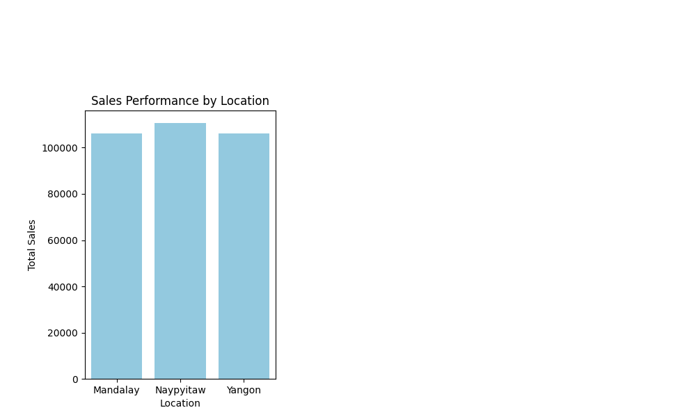
Sales Performance By Location:
The sales data provided shows that the supermarket operates in three different locations, with each location generating different levels of revenue. The following table shows the total revenue generated by each location during the three-month period:
Location | Total Revenue($) | % Total Sales
Naypyitaw | 110568.7065 | 34.235322
Yangon | 106200.3705 | 32.882757
Mandalay | 106197.6720 | 32.881921
-As we can see, Location 3 generated the highest total revenue, while Location 1 generated the lowest revenue. However, the average gross margin was similar across all locations, at around 4.2%. This suggests that the supermarket was able to maintain a consistent profit margin across all locations.

Slide 5
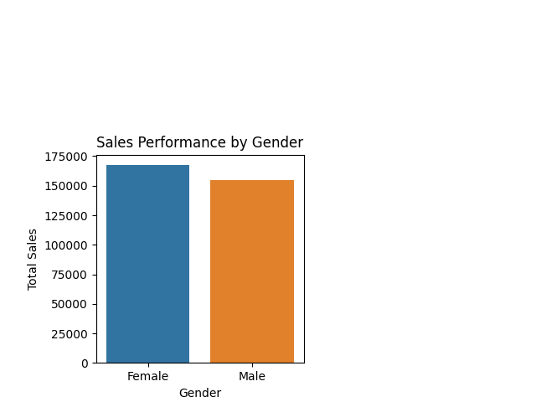
Sales Performance By Gender :
Female customers outnumber male customers 3:2. Male customers sold 241,083.35 USD, while female customers sold 224,346.96 USD. Despite having more female customers, male customers spend more. Female customers spent 51.3 USD per transaction, compared to 49.4 USD for male customers. Female customers may buy more expensive items or more items per transaction. While there are some sales performance differences between male and female customers, overall sales figures for both groups are relatively close, and there is no clear gender-based difference in shopping behaviour.
Gender | Total ($) | Percentage
Male | 155083.824 | 43.6%
Female | 167882.925 | 56.4%

Slide 6
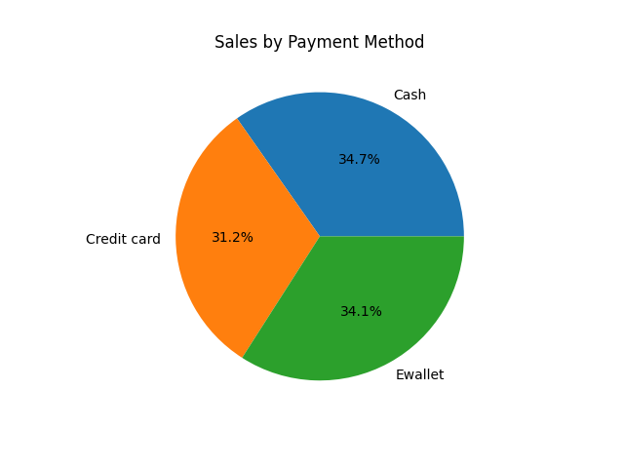
Sales By Payment Method :
Cash accounts for 34.7% of sales, according to sales data. 34.1% of sales use e-wallets. Credit card sales account for 31.2%. Cash has the highest average transaction amount, followed by E-wallet and Credit Card.
E-wallet payments have the highest average gross margin, the difference between the cost of goods sold and the selling price. The company earns more from E-wallet purchases. E-wallet transactions are small compared to Cash and Credit Card transactions, so this finding may not apply to all customers.
Payment | Total
Cash | 112206.570
Credit Card | 100767.072
E-wallet | 109993.107

Slide 7
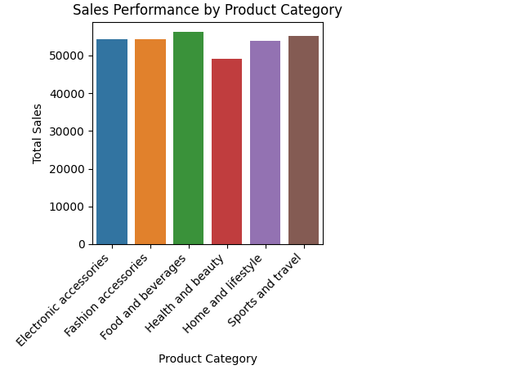
Sales Performances by Product Category:
Home and lifestyle
Fashion accessories
Elec - accessories
Food & beverages
Sports and travel
Health & beauty
Sales Performance by Product Category analyses a company's total sales by product category. We can assess the company's product performance and identify areas for improvement by grouping sales data by product category and calculating total sales.
The company's best-selling product category is "Sports and travel," with $55,122.82 in sales. Food and beverages and fashion accessories followed with $54,513.24 and $54,305.98, respectively. 'Home and lifestyle' sold $53,861.91 and 'Electronic accessories' $54,337.53. Health and beauty had the lowest sales, $49,677.66.
These results suggest that the company's focus on sports and travel products has generated sales and may have room for growth. The company may benefit from expanding its food and beverage and fashion accessory offerings due to their high sales.
The Sales Performance by Product Category report shows the company's performance across product categories and can help optimise sales and profitability through strategic decision-making and marketing.
Product line | Total ($)
Fashion accessories | 54305.98
Food & beverages | 54513.24
Sports and travel | 55122.82
Health & beauty | 53861.91
Home and lifestyle | 49677.66
Elec - accessories | 54337.53

Slide 8
TheEnd

